Slide 1
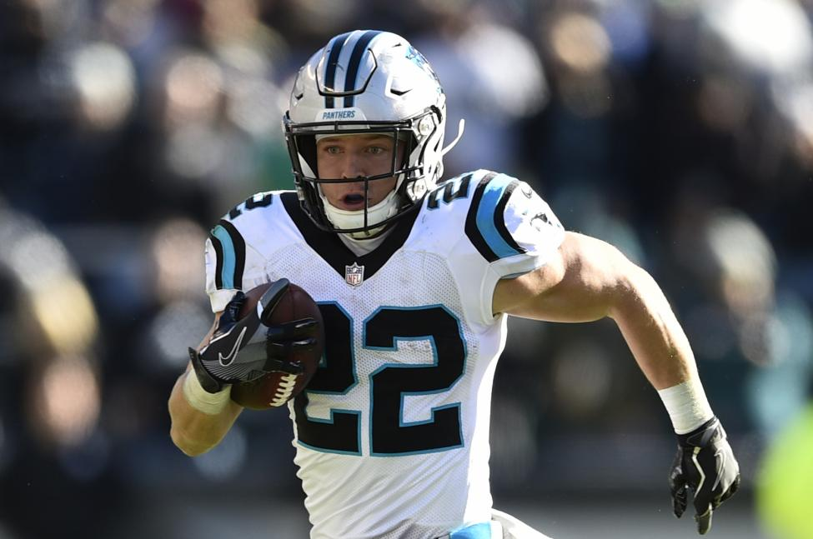
Data Science in R:
Fantasy Football

Slide 2
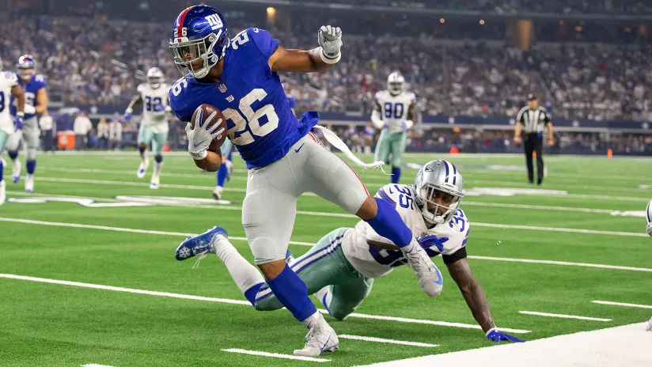
Overview
●Problem Statement: Who is the best running back to draft?
●Exploratory Visualizations: Seeing the data
●Linear Regression Analysis: Key Data Insights
●Results & Conclusion

Slide 3
Problem Statement
●The goal of any team in fantasy football is to score as many points as possible every week. In order to accomplish this, it’s important to have a strong draft at the beginning of the season.
● Deciding which players to draft in fantasy football can be a difficult process. This project focuses specifically on the running back position and attempts to predict which variables are the most important in ranking players for future drafts.

Slide 4
Exploratory Visualizations

Slide 5
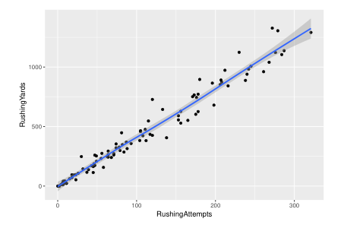
Rushing Yards Trends
Strong linear relationship
More rushing attempts = more rushing yards
Focus on players with the highest rushing yards
Rushing yards and rushing attempts are highly correlated

Slide 6
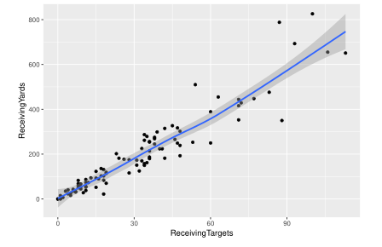
Receiving Yards Trends
Same relationship as rushing yards
More receiving yards = more fantasy points
Highly correlated

Slide 7
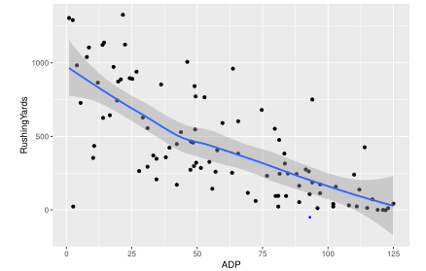
Predicting Average Draft Position - Rushing
Players with the highest rushing yards total were taken within the top 25 spots of next year’s draft
Outliers that were drafted high with little to no rushing yards the previous year could include rookies or injured star players
Risk in drafting rookies due to unavailable pro statistics

Slide 8
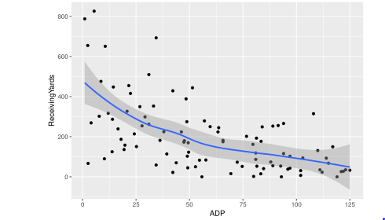
Predicting Average Draft Position - Receiving
Receiving yards alone is not as strong an indicator of ADP as rushing
Running back position more focused on rushing over receiving
There are a few running backs who became a big part of the passing game
Example - Christian Mccaffrey had 651 rushing yards as a rookie running back in 2017

Slide 9
Model Analysis

Slide 10
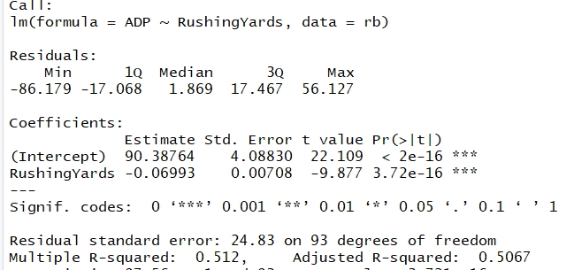
Rushing Yards Model
Very low chance of result happening due to random variation
Turned out to be a better fit than receiving alone
Only reviewed one variable in predicting average draft position
Next slide shows analysis of models with multiple variables

Slide 11
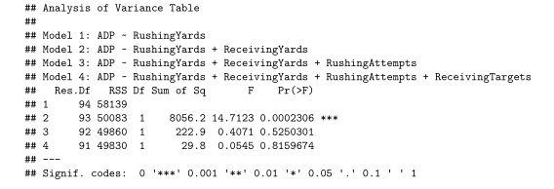
Linear Regression Analysis
Rushing and receiving yards together turned out to be the best fit model
This model was the most statistically significant when compared with all four that were run
Result is logical since gaining the most rushing and receiving yards will yield the most fantasy points

Slide 12
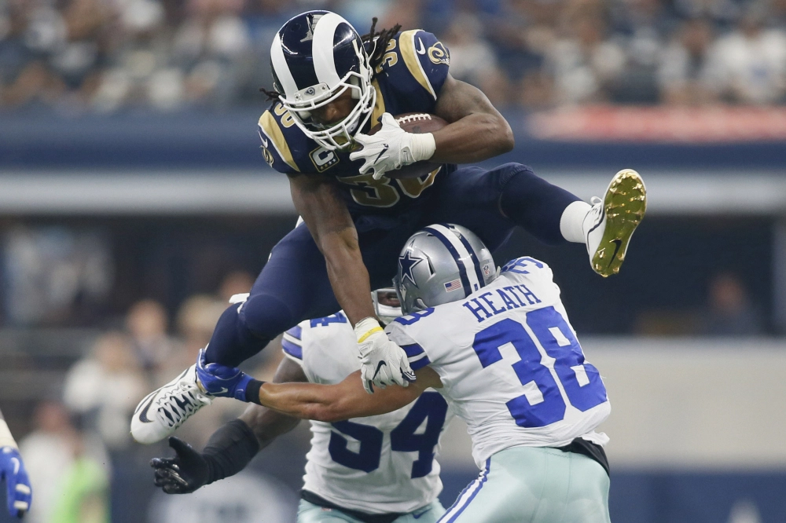
Conclusion
When ranking running backs for your fantasy draft, focus on rushing and receiving yards together
Model can be used for future drafts with updated datasets yearly
Ideas for further research include expanding scope to all positions in football to create the best possible complete fantasy football team

